Slide 1


Genetic parameters and genome-wide association studies of disease in growing pigs under a polymicrobial natural disease challenge
Usamah Kabuye
PhD student | Genetics and Genomics | Dr. Jack Dekkers’ lab
Animal Science Department
2025 NSIF Meeting October 14 - 16, Kansas City, MO

Slide 2
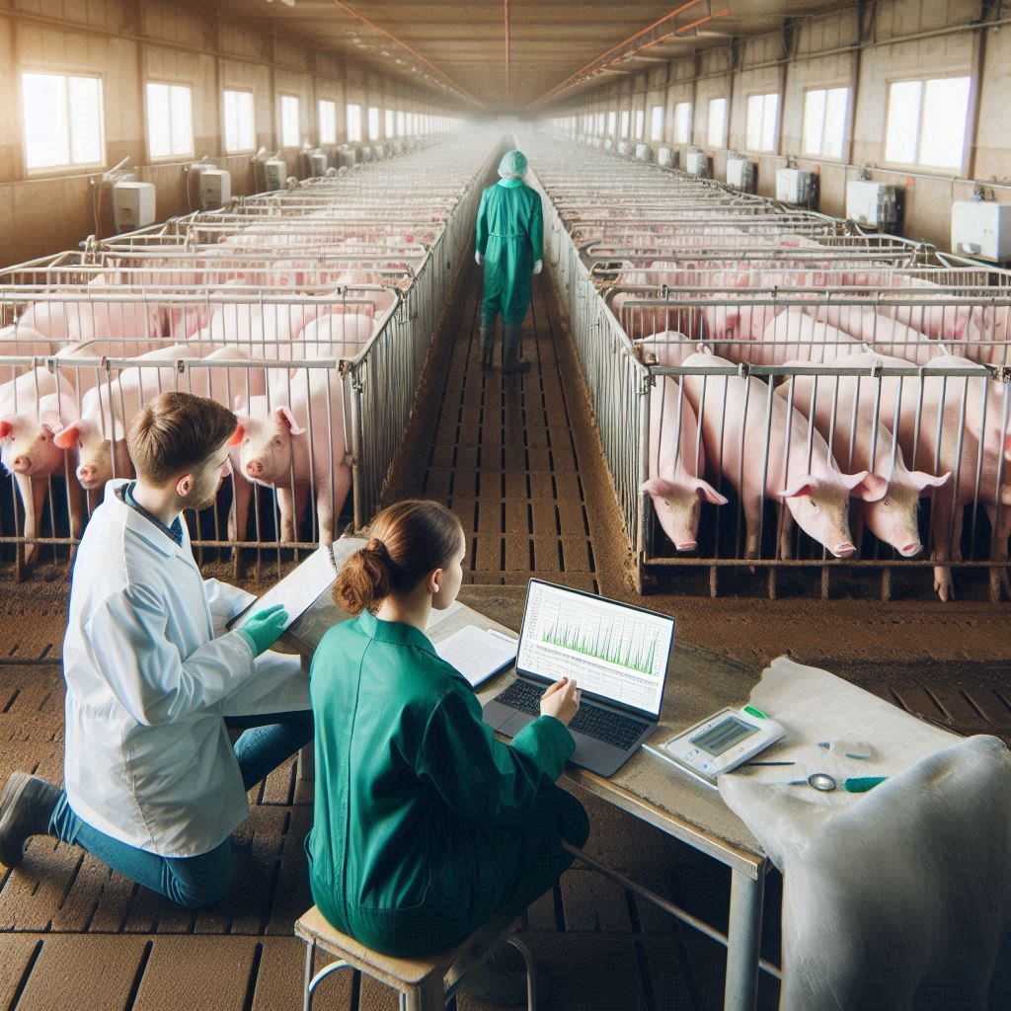
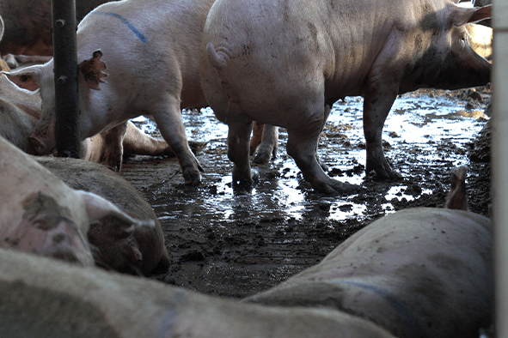





Introduction
Selection in most pig breeding programs is conducted in high-health nucleus herds, while pigs typically encounter multiple pathogens in commercial herds.
A knowledge gap remains on genetic parameters and genomics of disease-related traits of growing pigs under a polymicrobial disease challenge.
Objective
Estimate genetic parameters and identify genomic regions and pathways associated with disease of growing pigs exposed to a natural polymicrobial disease challenge.
Department of Animal Science

Slide 3

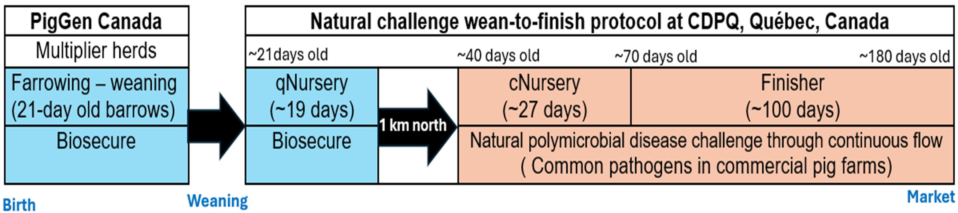
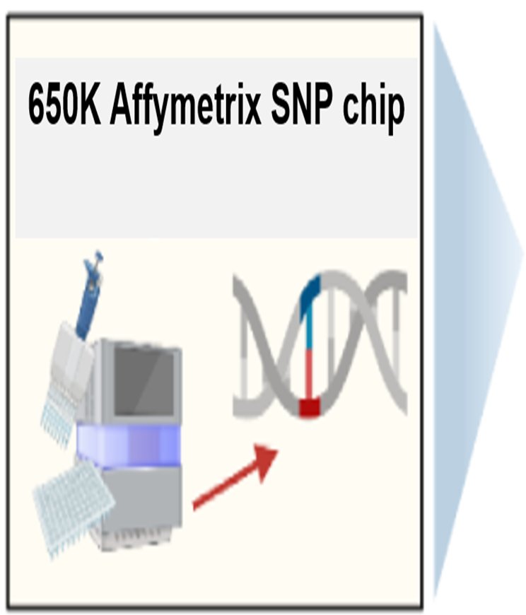
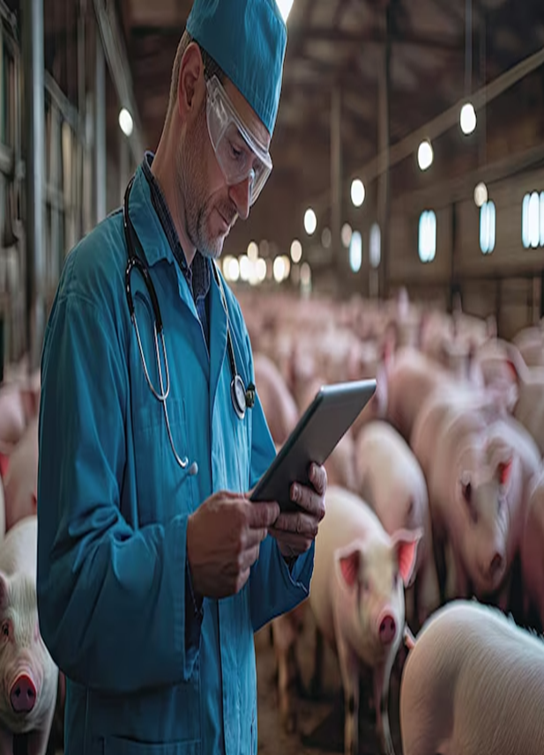

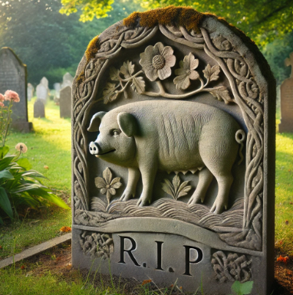
Materials and methods
A three-phase natural polymicrobial disease challenge (Putz et al.,2019, Frontiers in Genetics)
Disease resilience data collection
Animals and genotyping
4,095 Y × LR barrows
65 batches (each ~60 -75 pigs)
Phenotypic data - Individual health treatments and mortality records categorized as:
Meningitis
Respiratory distress
Scours
Unthriftiness
Other viral and/or bacterial infections
Variance Component Estimation and GWAS: Uni- and bi-variate analyses using generalized and mixed linear models with genomics (ASReml 4.2) and GWAS using JWAS software.
Model: y_{ijkl} = Batch_{i} + EntryAge_{ijkl} + Pen_{j} + Sow_{ijk} + Pig(grm)_{ijkl} + e_{ijkl}
Gene Ontology term enrichment analyses: of 0.25 Mb windows that did not reach significance, using GSEA 4.3.3 software.
Department of Animal Science

Slide 4
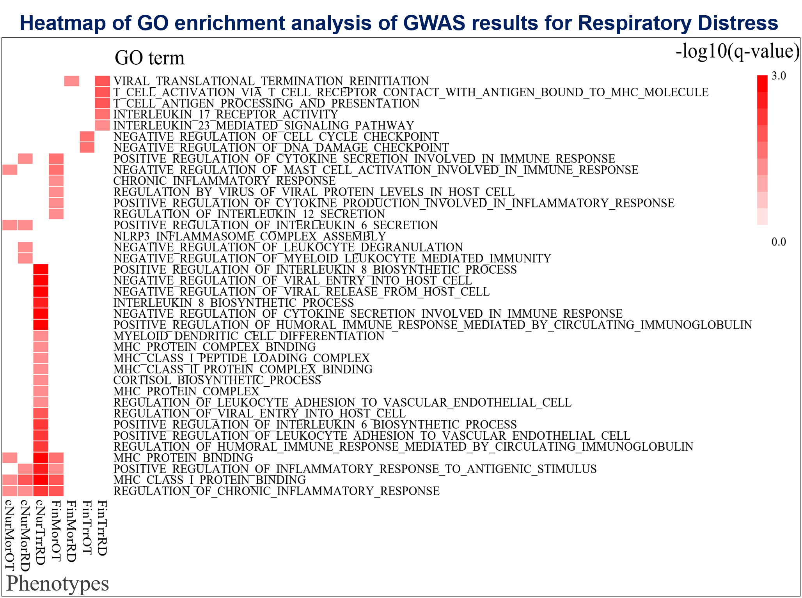
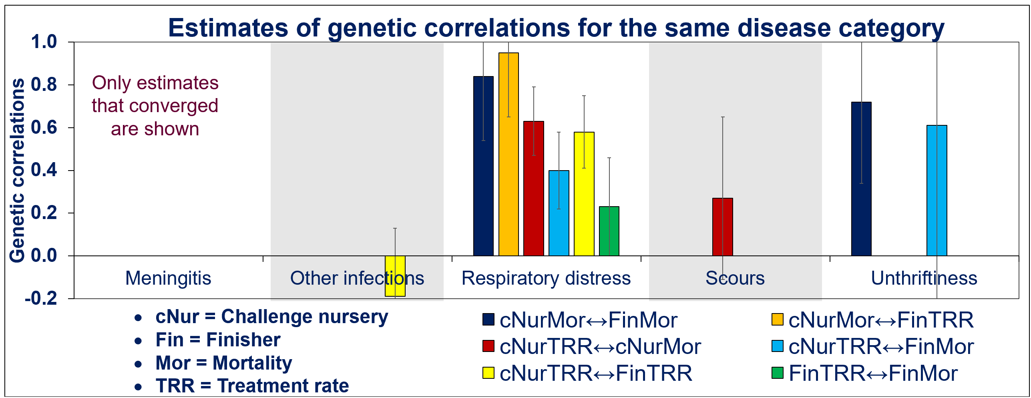
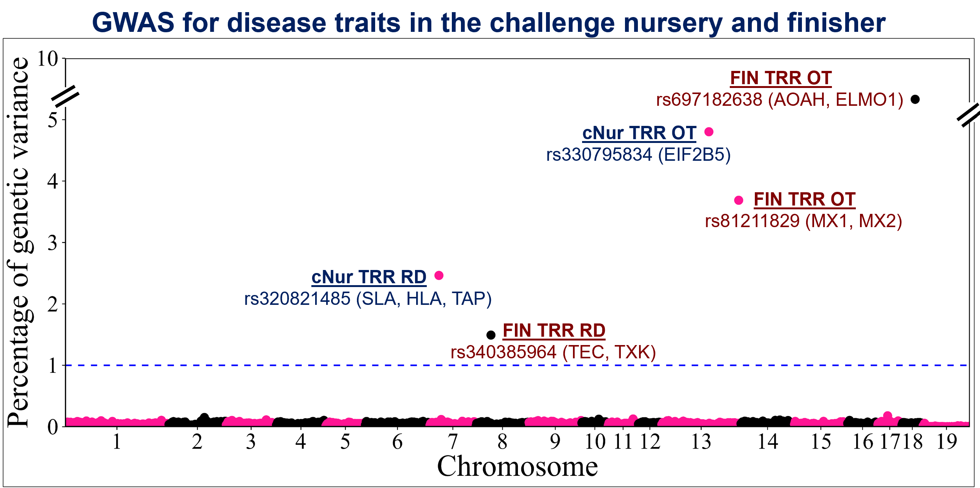
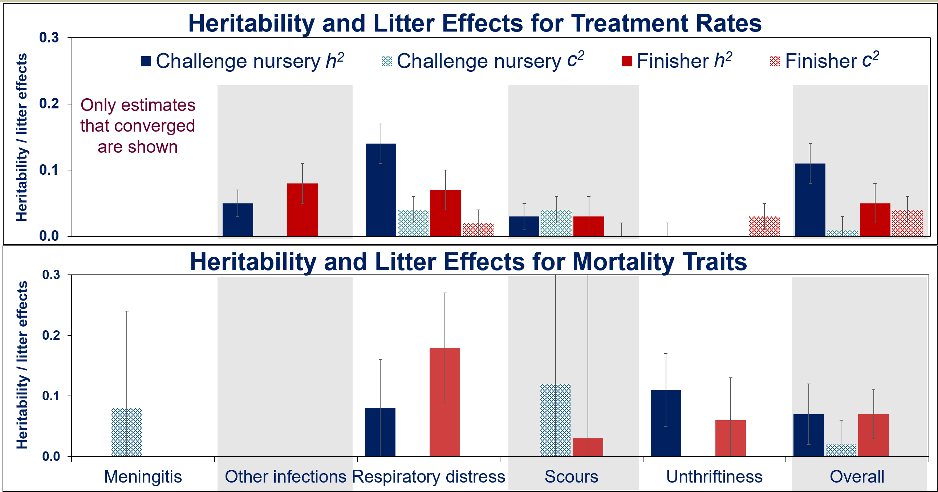
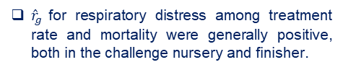
Results
Respiratory distress treatment rate and mortality tended to have higher heritability estimates, both in the nursery and finisher
Litter effects were generally low, but stronger in the challenge nursery.
${\hat{r}}_{g}$for respiratory distress among treatment rate and mortality were generally positive, both in the challenge nursery and finisher.
GWAS identified several genomic regions and candidate genes
GSEA identified several enriched biological processes e.g. disease susceptibility and immune capacity.
Department of Animal Science

Slide 5
Key points
Respiratory distress treatment rate and mortality are substantially influenced by genetics, making it a key target for genetic selection.
Litter effects are critical in early life stages but diminish as the pigs mature.
Selection strategies to improve health treatment and mortality traits should be balanced to avoid unintended consequences.
Genetic parameters and genomics provide the roadmap for breeding programs, and this study provides valuable information to breed for disease resilience in pigs.
Manuscript under preparation
Department of Animal Science

Slide 6




Acknowledgements
Co-authors:
John Harding
Michael Dyck
Frederic Fortin
Graham Plastow
PigGen Canada
Jack Dekkers
Funding from Genome Canada, Genome Alberta, Genome Prairie, PigGen Canada, USDA NIFA (2017-67007-26144), and the National Pork Board Survivability Project
Department of Animal Science

